Slide 1
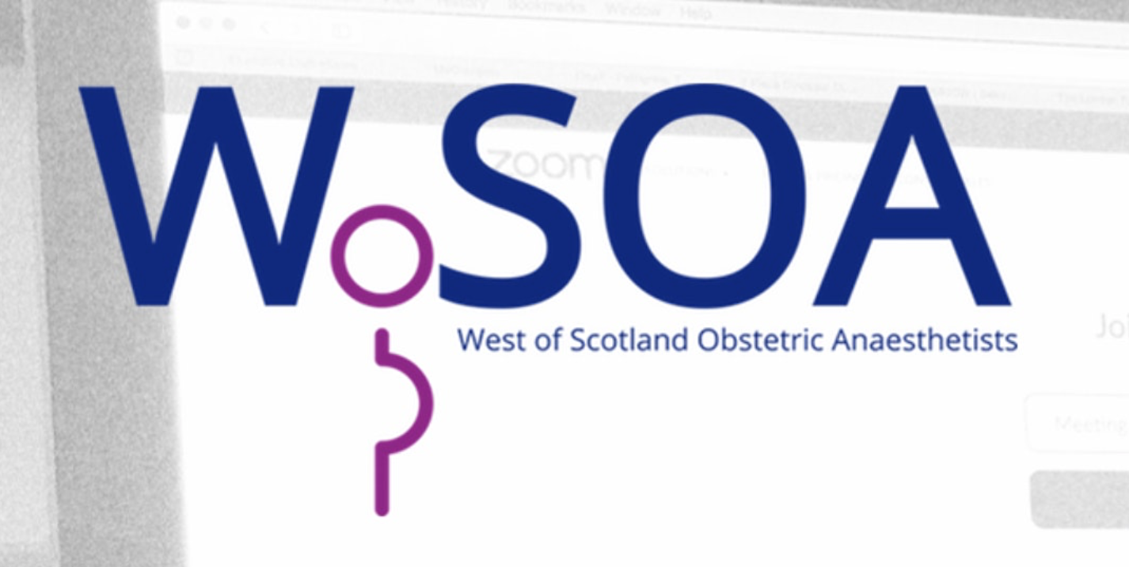
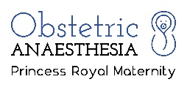
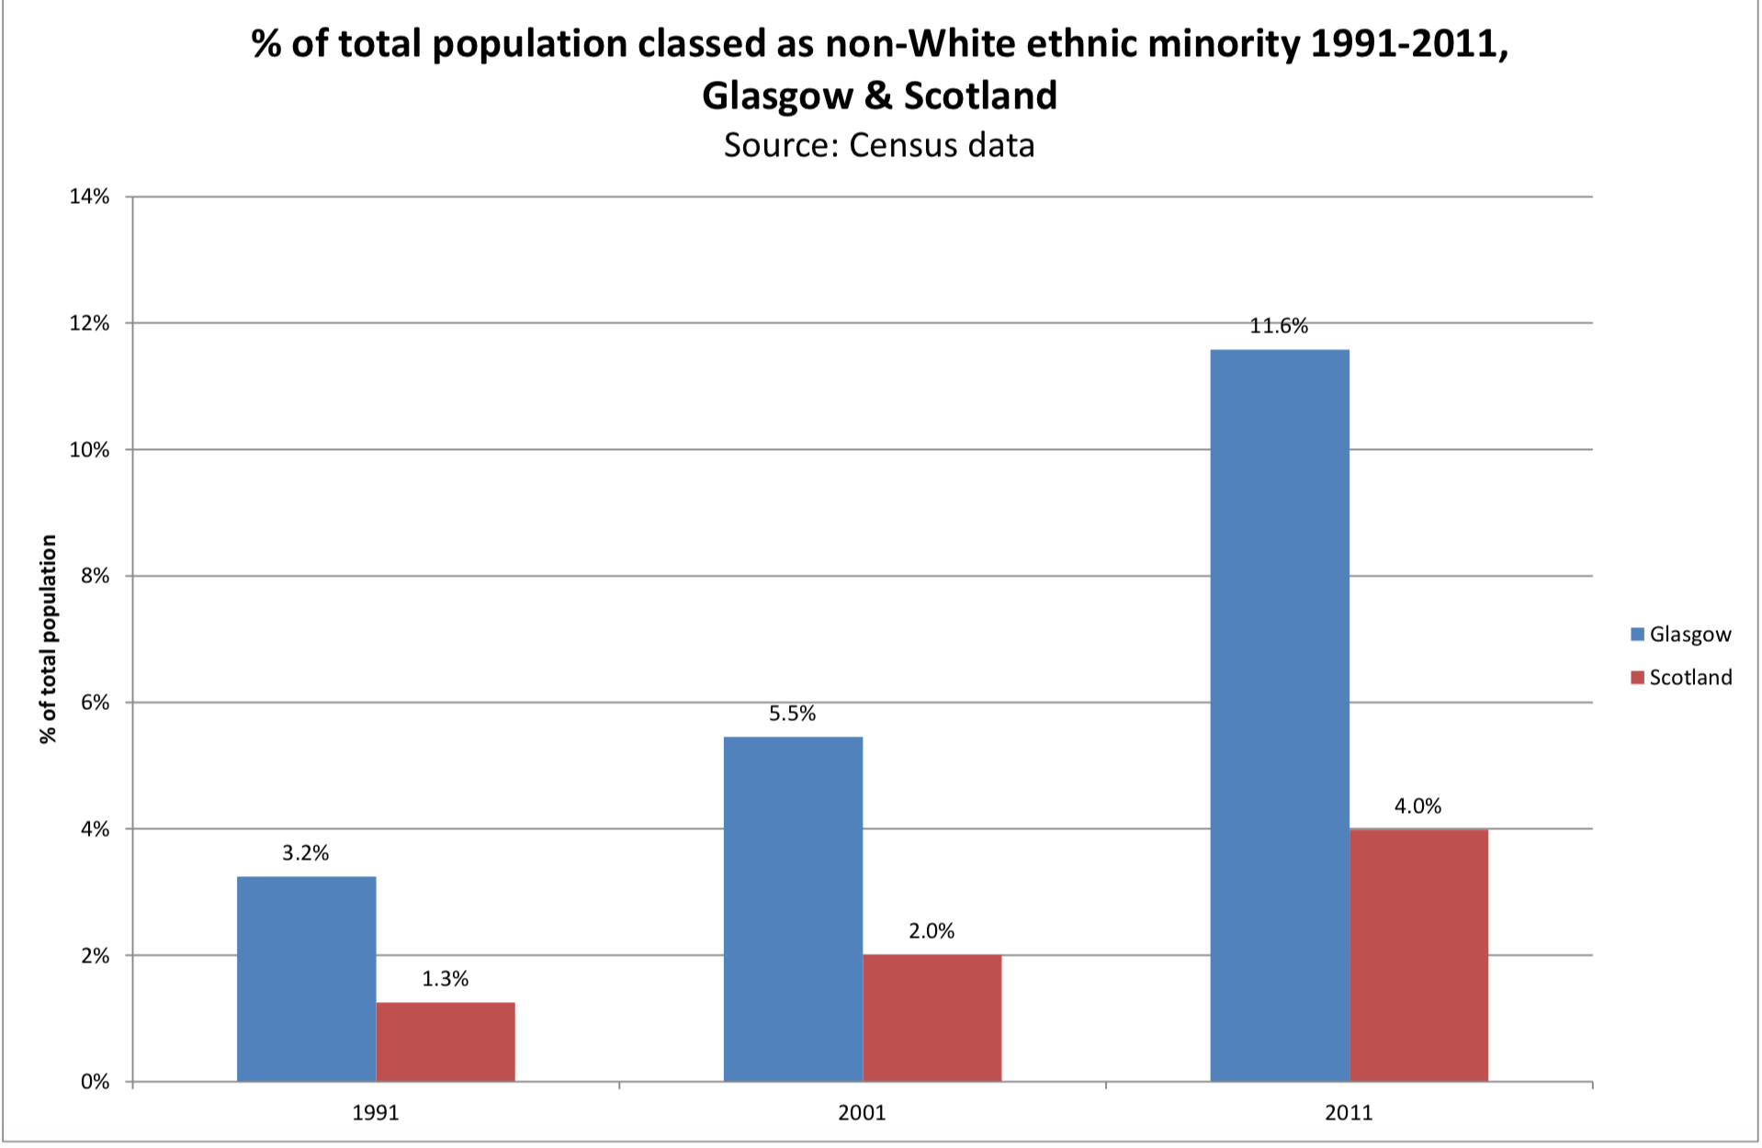
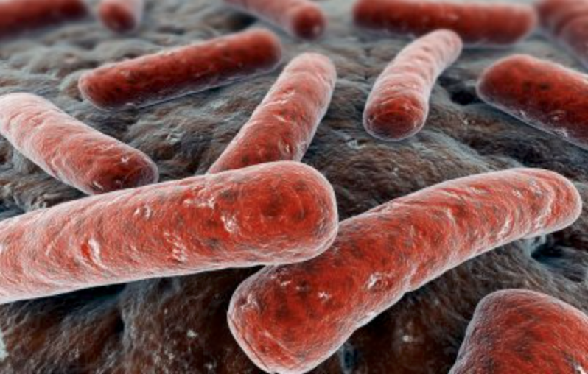
Tropical disease in the West of Scotland: A case report Andrews H (CT2), Lake K, Kearns RJ Princess Royal Maternity Hospital, Glasgow Royal Infirmary
Case Report
Discussion
A 26-year old, non-English-speaking Sudanese primagravida presented in early pregnancy to maternity services at Glasgow Royal Infirmary. She had recently received a diagnosis of lepromatous leprosy following a medical admission for widespread rash, nosebleeds and lower limb hypoesthesia.
The patient was managed throughout by infectious disease physicians. Treatment was initially with high dose prednisolone with addition of ‘DOTS’ (Rifampicin, Clofazimine and Dapsone) a few months later. A multidisciplinary meeting was held to discuss delivery planning and she was reviewed by an obstetric anaesthetic consultant. Investigations included regular full blood counts, postural blood pressures and an ECG.
Key concerns were her anaemia and thrombocytopaenia thought to be secondary to a combination of Dapsone, sickle cell trait, and pregnancy-related causes. She was no longer considered to be infectious from a leprosy point of view but around time of induction she tested positive for SARS-CoV-2.
The patient was induced at 38 weeks for IUGR and went on to have an SVD with 1.2l of blood loss. She required no peri-partum anaesthetic input.
Previously thought to have been eradicated as a public health problem, Leprosy cases have continued to rise, predominantly in India, Africa and South America with up to 200,000 new cases reported annually¹. This is relevant to local services as the ethnic minority population in Glasgow accounts for 11.6%^{fig.1}.
Leprosy has many potential implications for the anaesthetist. These include autonomic instability, cardiovascular compromise, drug related effects, and haematological derangements. The majority of anaesthetic planning arose from the need to risk stratify the balance of a general vs regional technique.
Regional anaesthesia was widely discussed. The patient’s earlier complaint of hypoesthesia had resolved and neurological examination was normal. With platelets at time of delivery 77x10⁹/l, it was agreed that an epidural would not be appropriate but a spinal performed by an experienced operator could provide safe anaesthesia. The patient had no lepromatous skin lesions overlying her lumbar spine to preclude spinal anaesthesia. General anaesthesia posed risks compounded by the patient’s positive SARS-CoV-2 status. On balance, regional anaesthesia would have been preferred if platelet count and clinical situation had allowed.
Key Points
With increasing migration, it is important that such cases are continually reported for education in a health service increasingly exposed to tropical disease.
Leprosy is not exclusively a cutaneous disease and can have many implications for the anaesthetist.
The multi-disciplinary approach to patient care is essential for effective management of high risk patients.
References
Figure 1. Glasgow’s population % ethnicity 1991-2011².
Figure 2. Mycobacterium Leprae under scanning electron microscope.
Mitra S, Gombar K. Leprosy and the anesthesiologist. Canadian Journal of Anesthesia 2000; 47: 1001-1007
Walsh D. The changing ethnic profiles of Glasgow and Scotland, and the implications for population health Glasgow Centre for Population Health Sept 2017

