Slide 1
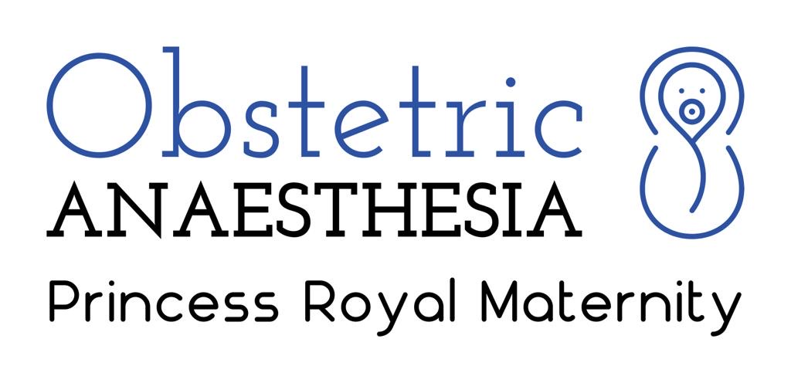
Characteristics of Obstetric Patients with Positive SARS-CoV-2 Sample within NHS Greater Glasgow and Clyde
McCallum A, Brown N, Litchfield K, Kearns R.
Princess Royal Maternity Hospital, Glasgow
Introduction
The UK Obstetric Surveillance System (UKOSS) report on pregnant women admitted with COVID-19 between March and April 2020 demonstrated an estimated hospitalisation rate with SARS-CoV-2 amongst pregnant patients of 4.9 per 1000 maternities, with risk factors for admission including black or minority ethnicity background, maternal age >35, raised BMI and pre-existing comorbidities.¹ We aimed to assess the local demographics and outcomes of pregnant and recently pregnant women with COVID-19 infection within NHS Greater Glasgow and Clyde (NHS GGC) and to compare this with the national data published by UKOSS.
 | All Patients (n=23) |  | Admitted Patients Only (n=14) |  | UKOSS (n=427)
 |  | % |  | % |  | %
Ongoing Pregnancy | 3 | 13.0% | 0 | 0.0% | 180 | 42%
Pregnancy Completed | 20 | 87.0% | 14 | 100.0% | 247 | 58%
Pregnancy Loss | 5 | 25.0% | 2 | 14.3% | 4 | 1%
Stillbirth | 0 | 0.0% | 0 | 0.0% | 3 | 1%
Live Birth | 15 | 75.0% | 12 | 85.7% | 240 | 97%
Neonatal Death | 0 | 0.0% | 0 | 0.0% | 2 | 1%
Competed Gestation
<22 weeks | 5 | 25.0% | 2 | 14.3% | 4 | 2%
22-27 Weeks | 0 | 0.0% | 0 | 0.0% | 5 | 2%
28-31 weeks | 2 | 10.0% | 2 | 14.3% | 17 | 7%
32-36 weeks | 2 | 10.0% | 2 | 14.3% | 41 | 17%
37 weeks | 11 | 55.0% | 8 | 57.1% | 180 | 73%
Median [IQR] | 37 [25-39] |  | 37 [30-5-38.75] |  | 38 [36-40]
Mode of Birth
Caesarean - Due to SARS-CoV-2 | 2 | 13.3% | 2 | 16.7% | 39 | 16%
Other Caesarean | 8 | 53.3% | 6 | 50.0% | 105 | 43%
Operative Vaginal | 0 | 0.0% | 0 | 0.0% | 25 | 10%
Unassisted Vaginal | 5 | 33.3% | 4 | 33.3% | 76 | 31%
Results
741 females of child-bearing age tested positive for SARS-CoV-2 within the study period. Twenty-three were pregnant or recently pregnant, with fourteen (61%) requiring hospital admission (5.1 per 1000 maternities). As with UKOSS, cough and fever were the most frequent symptoms in admitted patients. 58% of UKOSS patients had delivered at the time of reporting, whereas all our admitted patients had completed their pregnancies, given the long time period for data collection.
Amongst our admitted patients, median age was 31.5 [29.3-34.0], median gestation at diagnosis 30.5 [24.3-37.5] weeks and 8 patients (57%) were of white ethnicity. Three hospitalised patients (21.4%) required oxygen therapy and one required post-operative ICU monitoring. Of the sixteen neonates born, 3 (18.8%) required resuscitation, and 2 (12.5%) had Apgar score at 5 minutes of < 7. No neonatal deaths occurred. No infants tested positive for SARS-CoV-2, however neonatal testing rates were low (18.8% of all neonates) Pregnancy and infant outcomes are shown in Table 1.
Methods
All female patients of child-bearing age diagnosed as having SARS-CoV-2 using PCR testing during the period 16th March – 3rd June 2020 were retrospectively identified by the NHS GGC Infection Prevention and Control team. Caldicott Guardian approval was obtained and requirement for formal ethical review waived.
Data were cross-referenced with local electronic notes systems (Badgernet, Clevermed & Clinical Portal, Orion Healthcare ) to identify pregnant or recently pregnant women (within 6 weeks post-partum). These data were then compared to UKOSS data, which reported only on patients admitted to hospital with COVID-19. Collected data were de-identified prior to analysis and analyses performed using R statistical software. Descriptive statistics are reported with results expressed as mean (SD), median [IQR], or n (%).
Discussion
The number of obstetric COVID-19 cases within NHS GGC was in keeping with national figures and the low incidence may reflect adherence of pregnant women to shielding advice. SARS-CoV-2 positive mothers who were obese or who were from minority ethnic groups were more likely to be admitted to hospital. Patients admitted to hospital, however, tended not severely unwell and required mainly level 1 care. Pregnancy loss and preterm deliveries were more common in GGC compared with data from UKOSS, however the reasons for this are unclear.
References:
1. Knight M et al. Characteristics and outcomes of pregnant women admitted to hospital with confirmed SARS-CoV-2 infection in UK: national population based cohort study. BMJ 2020; 369: m2107

