Slide 1
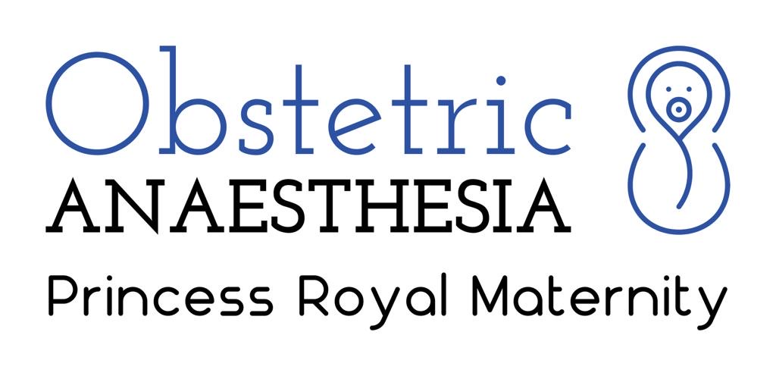
COVID-19 and Obstetrics: A Developing Second Wave?
McCallum A, Brown N, Campbell R, Litchfield K, Kearns R.
Princess Royal Maternity Hospital, Glasgow
Introduction
The recent upsurge in cases of COVID-19 throughout Europe has prompted concerns of a developing “second wave” of infections.¹ Published data from the first wave of cases demonstrates rates of COVID-19 infection within the obstetric community of around 10%, with around 1 in 20 asymptomatic mothers attending hospital being positive for the virus². Here, we investigate the rates of SARS-CoV-2 infection amongst pregnant women within NHS Greater Glasgow and Clyde (NHS GGC) during both in the initial “first wave” of infections seen in Spring 2020 and more recently. We aimed to compare the characteristics and outcomes of patients during both time periods.
Results
As shown in Figure 1, during the first wave of the pandemic, 23 pregnant or recently pregnant women tested positive for SARS-CoV-2; of these 14 (61%) were admitted to hospital. No positive cases occurred between June-August, however since September a total of 38 patients have tested positive, with 11 being admitted to hospital (29%). This represents a significant reduction in admission rates (p=0.018). In both waves of infection, patients have required mainly level one care.
In both cohorts, cough and fever were the most prevalent symptoms, although both were more prevalent in the first wave (cough present in 60% in 1st wave and 37% second wave; fever present in 53% in the first wave and 26% in the second wave). Three patients (13%) were asymptomatic in the “first wave” of cases, with four patients (10.5%) asymptomatic in the second cohort. Characteristics of patients within the different “waves” of infection are as shown in Table 1.
Methods
Caldicott Guardian approval was obtained and requirement for formal ethical review waived by the West of Scotland Research Ethics Service. All female patients of child-bearing age with a positive SARS-CoV-2 test between 11th March – 15th October 2020 were identified by the NHS GGC Infection Prevention and Control team. These patients were cross-referenced to local electronic notes systems to identify pregnant or recently pregnant women (within 6 weeks post-partum). “First” wave was described as occurring between 1st March to 31st May 2020, “second” wave was defined as 1st September to 31st October. Collected data were de-identified prior to analysis and Chi-Squared statistical analyses performed using GraphPad statistical software. Descriptive statistics are reported with results expressed as mean (SD), median [IQR], or n (%).
 | 1st wave Cases |  | 2nd Wave Cases
n= | n=23 | % | n= 38 | %
Age
<20 | 0 | 0.0% | 0 | 0.0%
20-34 | 18 | 78.3% | 30 | 78.9%
>34 | 5 | 21.7% | 8 | 21.1%
BMI
Low | 1 | 4.3% | 2 | 5.3%
Normal | 4 | 17.4% | 12 | 31.6%
Overweight | 4 | 17.4% | 9 | 23.7%
Obese | 7 | 30.4% | 14 | 36.8%
Ethnicity
White | 17 | 73.9% | 16 | 66.7%
Asian | 3 | 13.0% | 6 | 25.0%
Black | 2 | 8.7% | 2 | 8.3%
Mixed | 1 | 4.3% | 0 | 0.0%
Pre-existing Medical Problems
Asthma | 1 | 4.5% | 1 | 2.6%
Pre-eclampsia | 2 | 9.1% | 1 | 2.6%
Gestational Diabetes | 0 | 0.0% | 5 | 13.2%
Parity
Prim | 10 | 43.5% | 12 | 31.6%
Multi | 13 | 56.5% | 26 | 68.4%
Multiple Pregnancy | 1 | 4.3% | 1 | 2.6%
Gestation @ Symptom Onset (weeks)
Median [IQR] | 26 | 0.0% | 27 | (20.5-32)
<22 | 9 | 39.1% | 10 | 26.3%
22-27 | 4 | 17.4% | 9 | 23.7%
28-31 | 4 | 17.4% | 8 | 21.1%
32-36 | 2 | 8.7% | 6 | 15.8%
37+ | 1 | 4.3% | 5 | 13.2%
Post-partum | 3 | 13.0% | 0 | 0.0%
Discussion
We demonstrate the total number of reported infections amongst obstetric patients in the two months from September to be already greater than that see in the first wave of infections in Spring. Recent infections have tended to occur at a later gestation than in the first wave, however less patients have required admission to hospital. Rates of patients requiring oxygen have been almost identical (13.0% in first wave vs. 13.2% in second wave).
Greater access to testing may account for the higher rates of cases diagnosed recently and it is reassuring that most patients have not been severely unwell with infection. However, the rise in infection numbers highlights the ongoing need for precautions to limit the spread of infection and ongoing data collection and analyses to investigate the impact of this developing second wave.
Figure 1: comparison of waves
Table 1: Demographics of patients testing positive for SARS-CoV-2 in each wave of infections
References:
1. Looi M-K. Br Med J 2020; 371: m4113.
2. Allotey J et al. Br Med J. 2020;370:m3320.

